Slide 1
Proximity Measures for Categorical Attributes
Prof.Aruna Malapati

Slide 2
Learning Objectives
Define and compute proximity measures between objects when the attributes are categorical

Slide 3
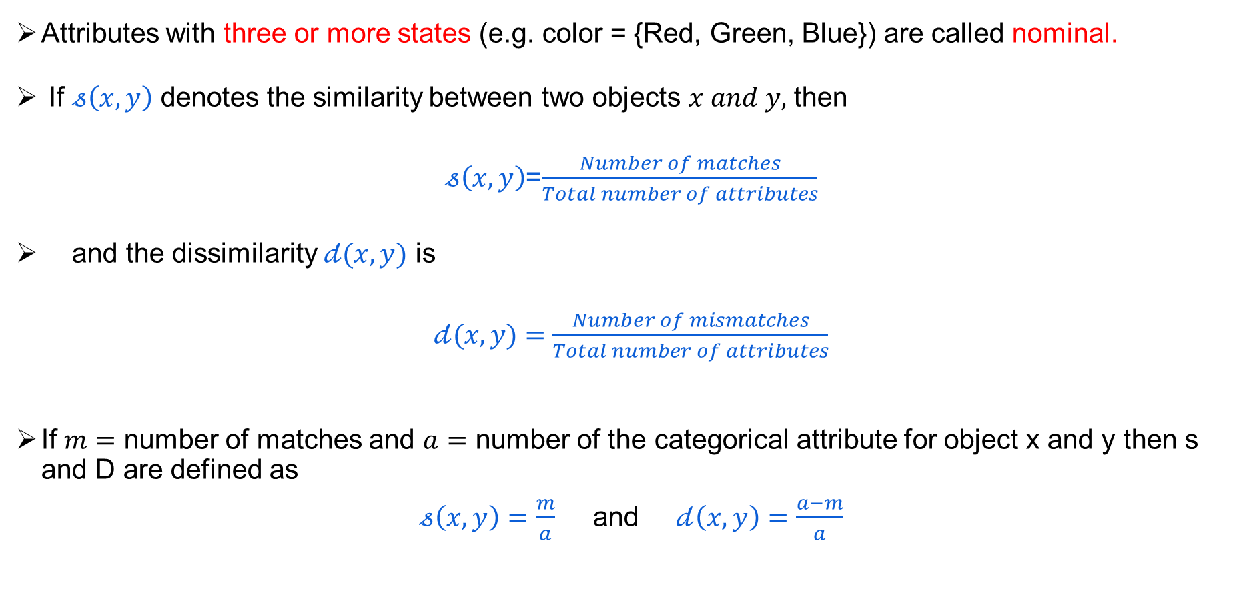
Proximity Measures for Categorical Attribute
Attributes with three or more states (e.g. color = {Red, Green, Blue}) are called nominal.
If $𝓈\left(x,y\right)$ denotes the similarity between two objects $x and y,$ then
$𝓈\left(x,y\right)$=$\frac{Number of matches}{Total number of attributes}$
and the dissimilarity $𝒹(x,y)$ is
$𝒹(x,y)$ $=\frac{Number of mismatches}{Total number of attributes}$
If $m=$ number of matches and $a=$ number of the categorical attribute for object x and y then s and D are defined as
$𝓈\left(x,y\right)=\frac{m}{a}$ and$𝒹\left(x,y\right)=\frac{a−m}{a}$
Notes:
Binary attribute is a special kind of nominal attribute where the attribute has values with two states only.

Slide 4
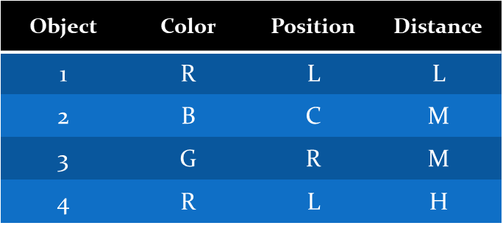
Proximity Measures for Categorical Attribute

Slide 5
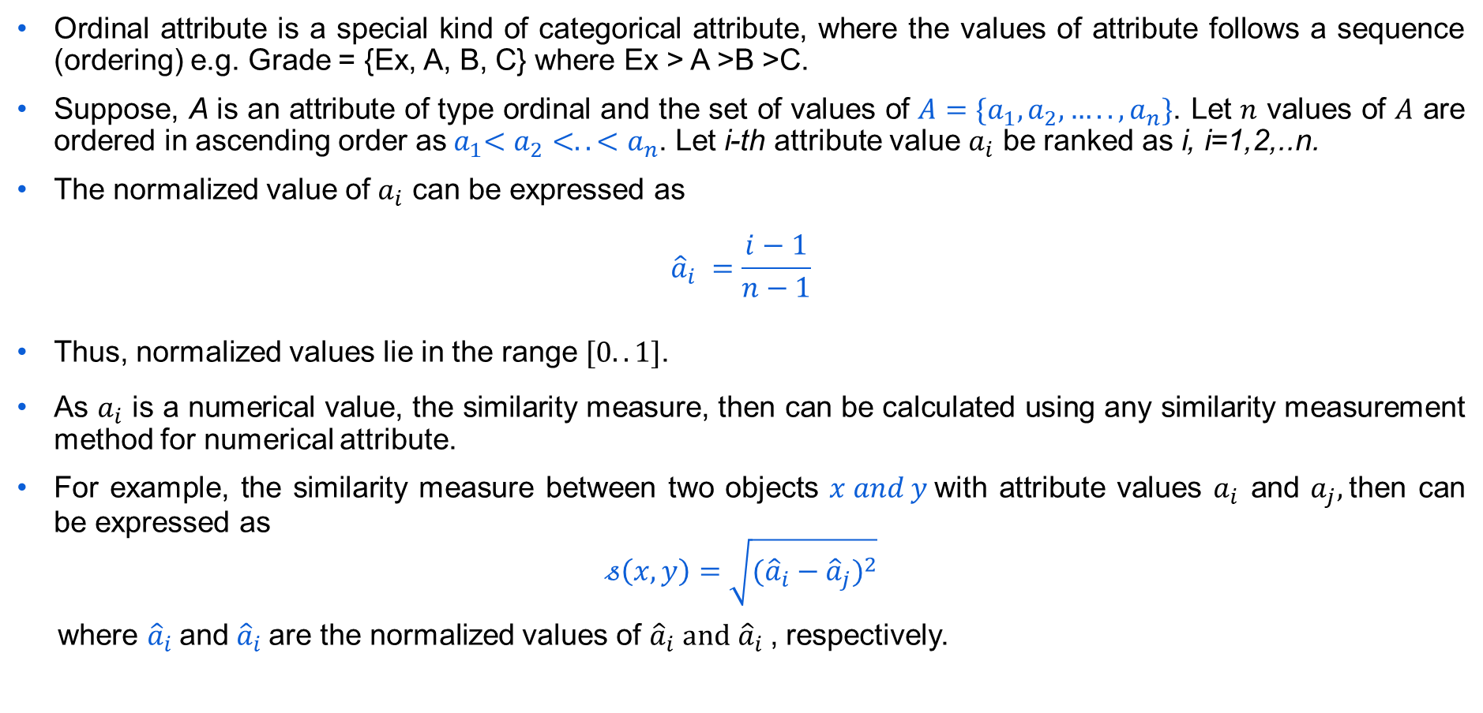
Proximity Measure for Ordinal Attribute
Ordinal attribute is a special kind of categorical attribute, where the values of attribute follows a sequence (ordering) e.g. Grade = {Ex, A, B, C} where Ex > A >B >C.
Suppose, A is an attribute of type ordinal and the set of values of ${A=\{a}_{1},a_{2},…..,a_{n}\}$. Let $n$ values of $A$ are ordered in ascending order as${ a}_{1}<a_{2}<..<a_{n}$. Let i-th attribute value $a_{i}$ be ranked as i, i=1,2,..n.
The normalized value of $a_{i}$ can be expressed as
$${\hat{a}}_{i} =\frac{i−1}{n−1}$$
Thus, normalized values lie in the range $[0..1]$.
As $a_{i}$ is a numerical value, the similarity measure, then can be calculated using any similarity measurement method for numerical attribute.
For example, the similarity measure between two objects $x and y$with attribute values $a_{i}$ and $a_{j},$then can be expressed as
$$𝓈\left(x,y\right)=\sqrt{({{\hat{a}}_{i}−{\hat{a}}_{j})}^{2}}$$
where ${\hat{a}}_{i}$and ${\hat{a}}_{i}$are the normalized values of ${\hat{a}}_{i} and$ ${\hat{a}}_{i}$, respectively.

Slide 6
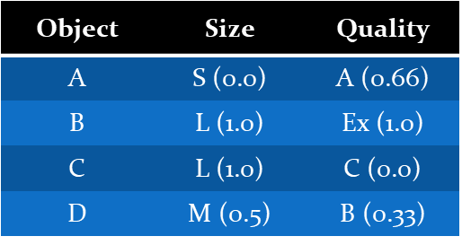
Proximity Measure for Ordinal Attribute
Consider the following set of records, where each record is defined by two ordinal attributes size={S, M, L} and Quality = {Ex, A, B, C} such that S<M<L and Ex>A>B>C.
Find the dissimilarity matrix, when each object is defined by only one ordinal attribute say size (or quality).

Slide 7
Thank You!
In our next session: Proximity Measures for continuous attributes

